Slide 1
TDIDT Learning
Notes:
Fall 2004
CS478 - Machine Learning

Slide 2
Decision Tree
Internal nodes ≡ tests on some property
Branches from internal nodes ≡ values of the associated property
Leaf nodes ≡ classifications
An individual is classified by traversing the tree from its root to a leaf

Slide 3
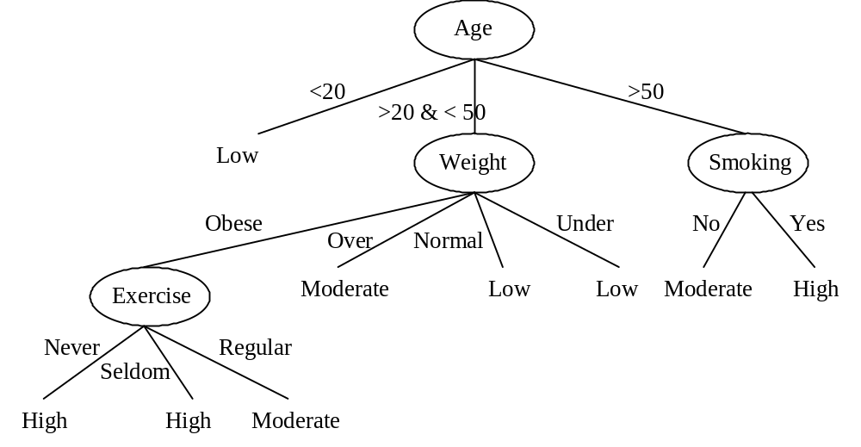
Sample Decision Tree

Slide 4
Decision Tree Learning
Learning consists of constructing a decision tree that allows the classification of objects.
Given a set of training instances, a decision tree is said to represent the classifications if it properly classifies all of the training instances (i.e., is consistent).

Slide 5
TDIDT
Function Induce-Tree(Example-set, Properties)
  If all elements in Example-set are in the same class, then return a leaf node labeled with that class
  Else if Properties is empty, then return a leaf node labeled with the majority class in Example-set
  Else
    Select P from Properties (*)
    Remove P from Properties
    Make P the root of the current tree
    For each value V of P
      Create a branch of the current tree labeled by V
      Partition_V ← Elements of Example-set with value V for P
      Induce-Tree(Partition_V, Properties)
      Attach result to branch V

Slide 6
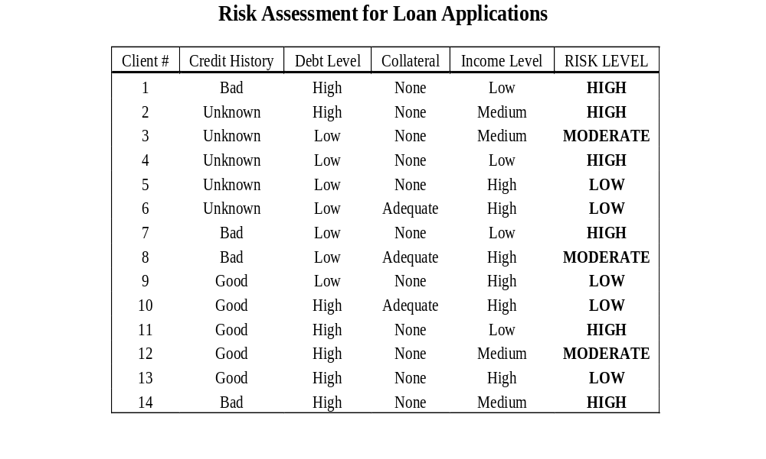
Illustrative Training Set

Slide 7
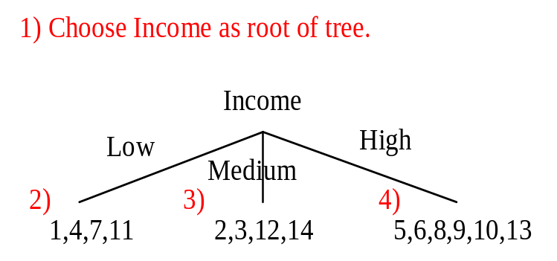
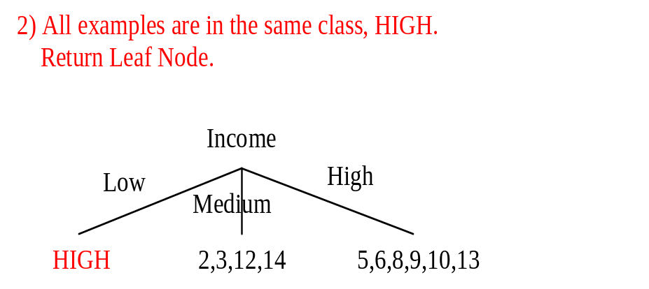
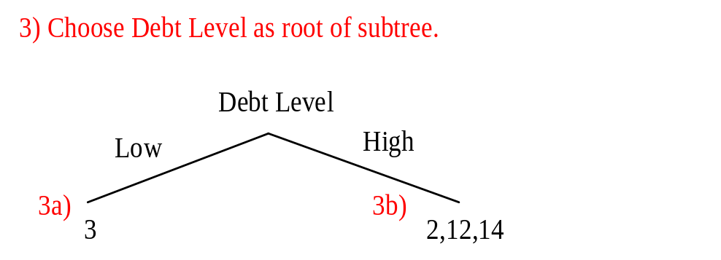
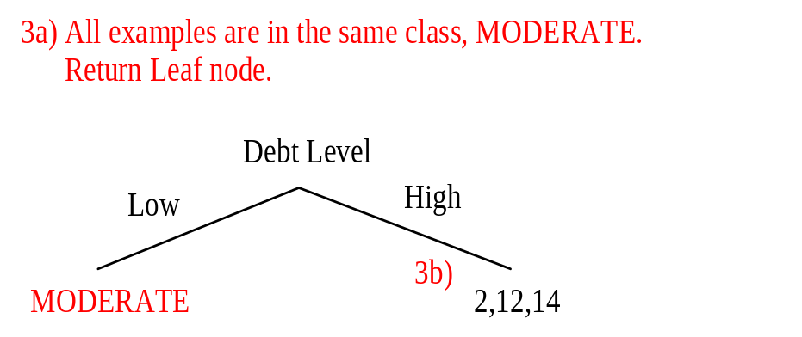
ID3 Example (I)

Slide 8
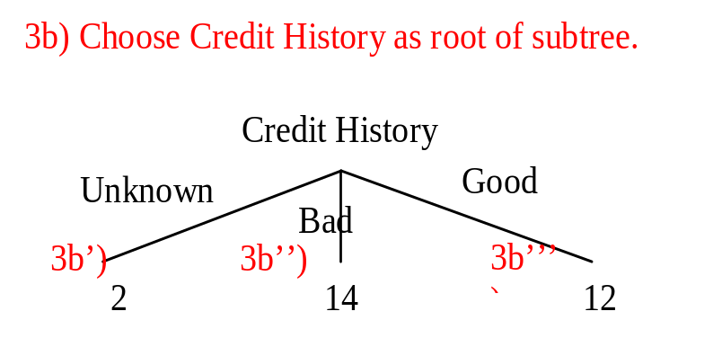
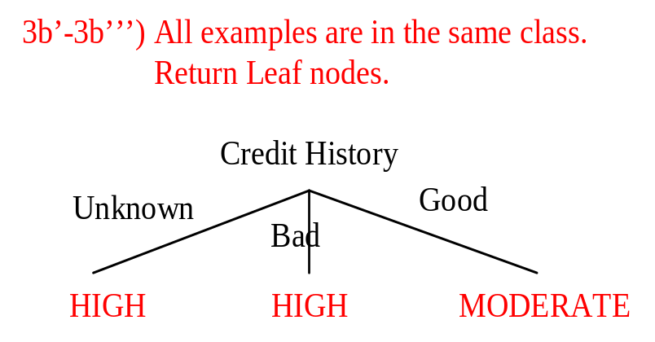
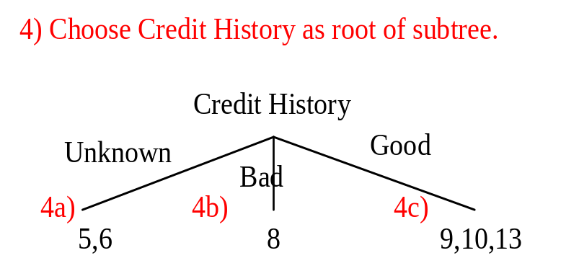
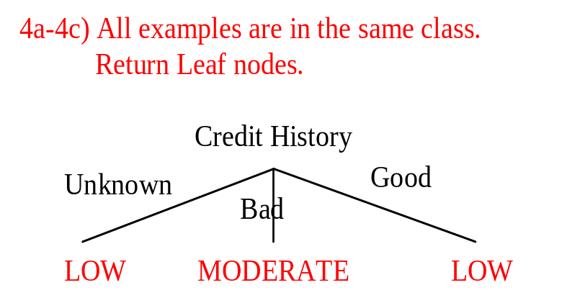
ID3 Example (II)

Slide 9
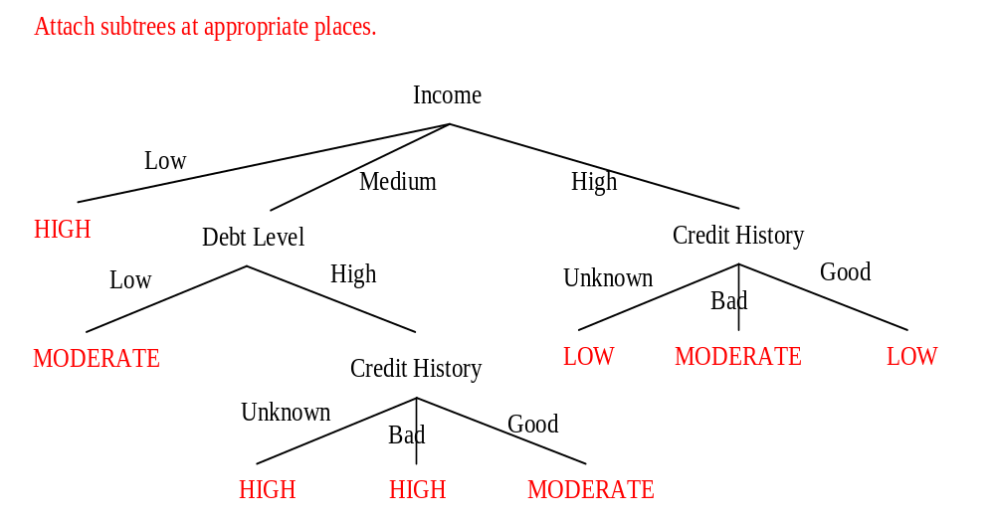
ID3 Example (III)

Slide 10
Non-Uniqueness
Decision trees are not unique:
  Given a set of training instances, there generally exists a number of decision trees that represent the classifications
The learning problem states that we should seek not only consistency but also generalization. So, …

Slide 11
TDIDT’s Question
Given a training set, which of all of the decision trees consistent with that training set has the greatest likelihood of correctly classifying unseen instances of the population?

Slide 12
ID3’s (Approximate) Bias
ID3 (and family) prefers the simplest decision tree that is consistent with the training set.
Occam’s Razor Principle:
  “It is vain to do with more what can be done with less...Entities should not be multiplied beyond necessity.”
  i.e., always accept the simplest answer that fits the data / avoid unnecessary constraints.

Slide 13
ID3’s Property Selection
Each property of an instance may be thought of as contributing a certain amount of information to its classification.
  For example, determine shape of an object: number of sides contributes a certain amount of information to the goal; color contributes a different amount of information.
ID3 measures the information gained by making each property the root of the current subtree and subsequently chooses the property that produces the greatest information gain.

Slide 14
Discussion (I)
In terms of learning as search, ID3 works as follows:
  Search space = set of all possible decision trees
  Operations = adding tests to a tree
  Form of hill-climbing: ID3 adds a subtree to the current tree and continues its search (no backtracking, local minima)
It follows that ID3 is very efficient, but its performance depends on the criteria for selecting properties to test (and their form)

Slide 15
Discussion (II)
ID3 handles only discrete attributes. Extensions to numerical attributes have been proposed, the most famous being C5.0
Experience shows that TDIDT learners tend to produce very good results on many problems
Trees are most attractive when end users want interpretable knowledge from their data

Slide 16
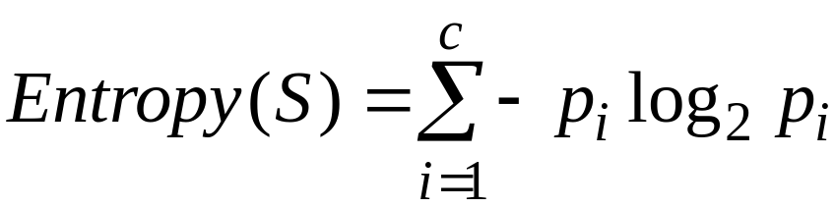
Entropy (I)
Let S be a set examples from c classes
Where p_{i} is the proportion of examples of S belonging to class i. (Note, we define 0log0=0)

Slide 17
Entropy (II)
Intuitively, the smaller the entropy, the purer the partition
Based on Shannon’s information theory (c=2):
  If p₁=1 (resp. p₂=1), then receiver knows example is positive (resp. negative). No message need be sent.
  If p₁=p₂=0.5, then receiver needs to be told the class of the example. 1-bit message must be sent.
  If 0<p₁<1, then receiver needs a less than 1 bit on average to know the class of the example.

Slide 18
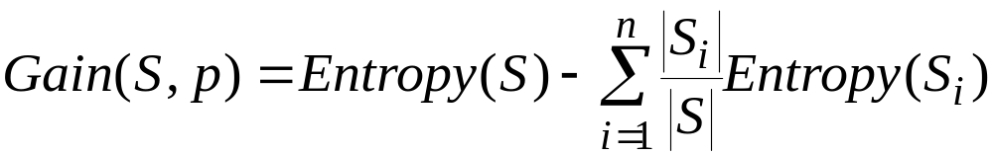
Information Gain
Let p be a property with n outcomes
The information gained by partitioning a set S according to p is:
Where S_{i} is the subset of S for which property p has its ith value

Slide 19
Play Tennis
OUTLOOK | TEMERATURE | HUMIDITY | WIND | PLAY TENNIS
Overcast | Hot | High | Weak | Yes
Overcast | Hot | Normal | Weak | Yes
Sunny | Hot | High | Weak | No
Sunny | Mild | Normal | Strong | Yes
Rain | Cool | Normal | Strong | No
Sunny | Mild | High | Weak | No
What is the ID3 induced tree?

Slide 20
ID3’s Splitting Criterion
The objective of ID3 at each split is to increase information gain, or equivalently, to lower entropy. It does so as much as possible
  Pros: Easy to do
  Cons: May lead to overfitting

Slide 21
Overfitting
Given a hypothesis space H, a hypothesis h∈H is said to overfit the training data if there exists some alternative hypothesis h’ ∈H, such that h has smaller error than h’ over the training examples, but h’ has smaller error than h over the entire distribution of instances

Slide 22
Avoiding Overfitting
Two alternatives
  Stop growing the tree, before it begins to overfit (e.g., when data split is not statistically significant)
  Grow the tree to full (overfitting) size and post-prune it
Either way, when do I stop? What is the correct final tree size?

Slide 23
Approaches
Use only training data and a statistical test to estimate whether expanding/pruning is likely to produce an improvement beyond the training set
Use MDL to minimize size(tree) + size(misclassifications(tree))
Use a separate validation set to evaluate utility of pruning
Use richer node conditions and accuracy

Slide 24
Reduced Error Pruning
Split dataset into training and validation sets
Induce a full tree from the training set
While the accuracy on the validation set increases
  Evaluate the impact of pruning each subtree, replacing its root by a leaf labeled with the majority class for that subtree
  Remove the subtree that most increases validation set accuracy (greedy approach)

Slide 25
Rule Post-pruning
Split dataset into training and validation sets
Induce a full tree from the training set
Convert the tree into an equivalent set of rules
For each rule
  Remove any preconditions that result in increased rule accuracy on the validation set
Sort the rules by estimated accuracy
Classify new examples using the new ordered set of rules

Slide 26
Discussion
Reduced-error pruning produces the smallest version of the most accurate subtree
Rule post-pruning is more fine-grained and possibly the most used method
In all cases, pruning based on a validation set is problematic when the amount of available data is limited

Slide 27
Accuracy vs Entropy
ID3 uses entropy to build the tree and accuracy to prune it
Why not use accuracy in the first place?
  How?
  How does it compare with entropy?
Is there a way to make it work?

Slide 28
Other Issues
The text briefly discusses the following aspects of decision tree learning:
  Continuous-valued attributes
  Alternative splitting criteria (e.g., for attributes with many values)
  Accounting for costs

Slide 29
Unknown Attribute Values
Alternatives:
  Remove examples with missing attribute values
  Treat missing value as a distinct, special value of the attribute
  Replace missing value with most common value of the attribute
    Overall
    At node n
    At node n with same class label
  Use probabilities

